Slide 1
RAD Curriculum Guide: Your roadmap for understanding RAD: Rental Assistance Demonstration
RAD 101
A. WHAT IS RAD AND WHY IS IT HAPPENING?
B. WHAT CAN YOU EXPECT?

Slide 2
RAD Curriculum Guide: Your roadmap for understanding RAD: Rental Assistance Demonstration
RAD 101: What is RAD and Why is it Happening?
Origins of Public Housing
RAD at a Glance
Conversion Basics

Slide 3
RAD Curriculum Guide: Your roadmap for understanding RAD: Rental Assistance Demonstration
ORIGINS OF PUBLIC HOUSING

Slide 4
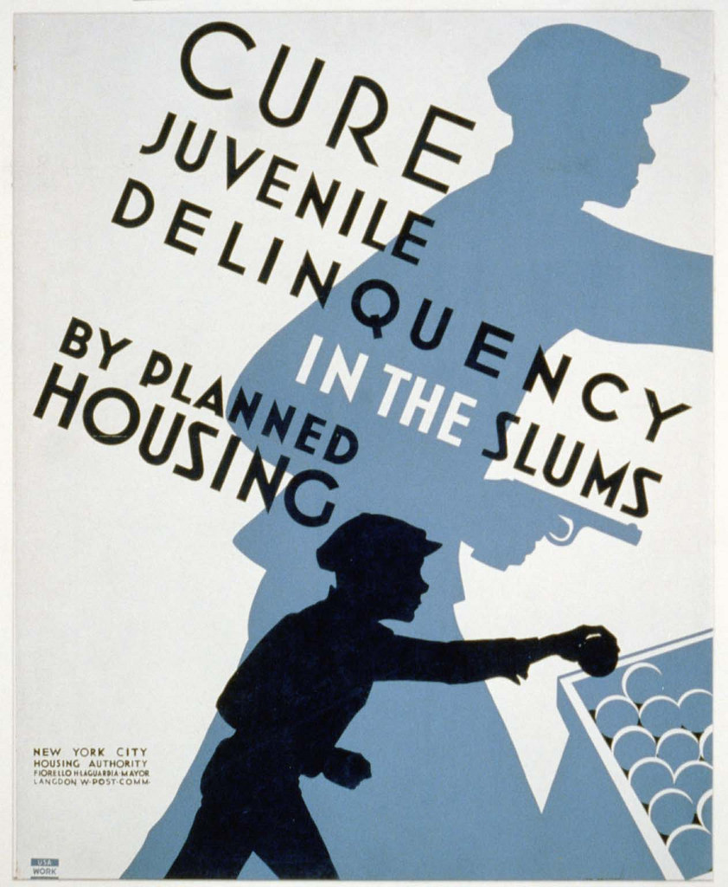
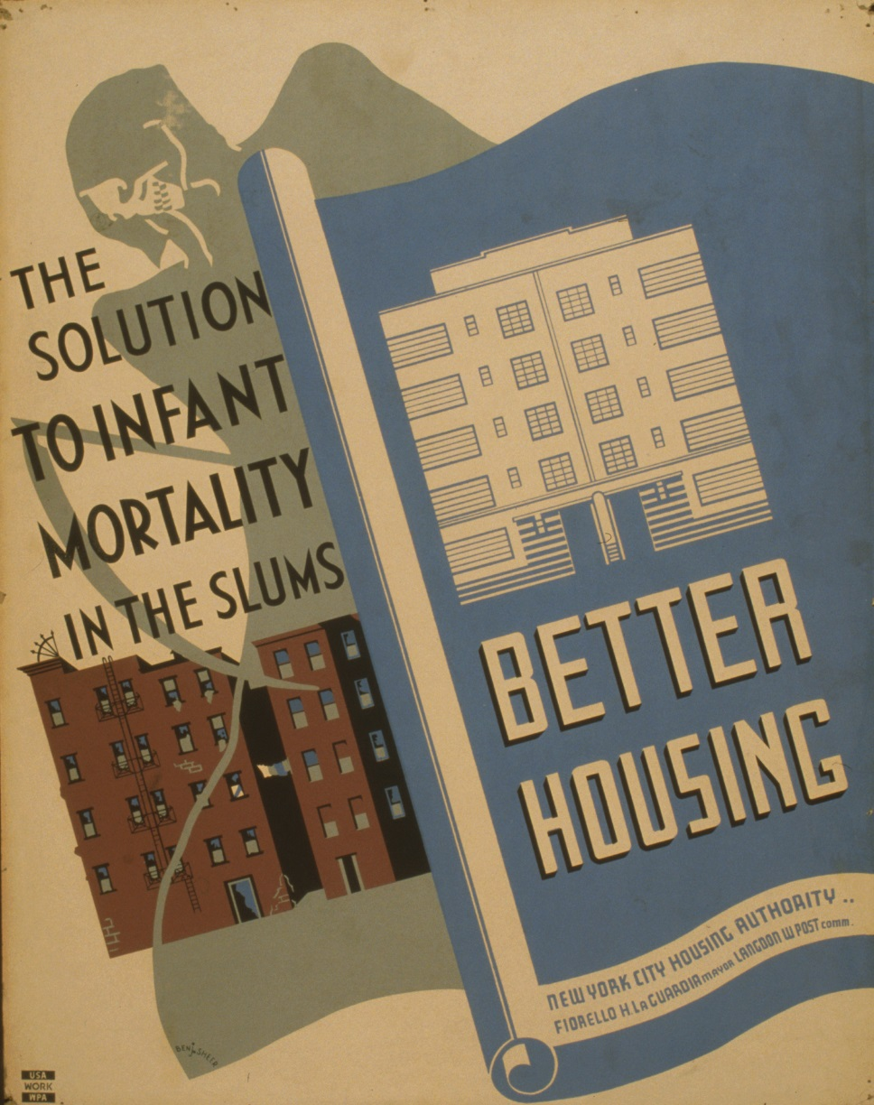
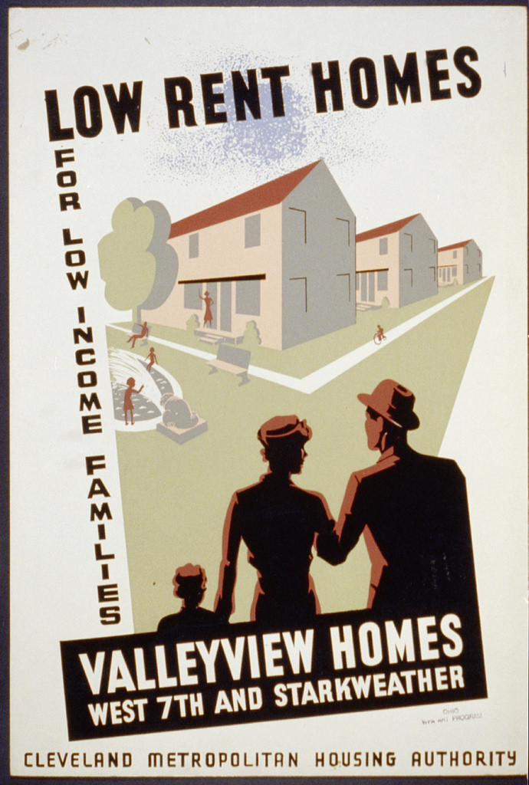
RAD 101: What is RAD and Why is it Happening?
ORIGINS OF PUBLIC HOUSING
Notes:
To understand What RAD it is important to examine the historical events that led to the current circumstances that prompted the creation of RAD

Slide 5
RAD 101: What is RAD and Why is it Happening?
ORIGINS OF PUBLIC HOUSING
Public Housing was initially created to:
Address substandard living conditions and public health concerns in slums;
Assist working families for whom the private housing market was out of reach; and
Help returning war veterans secure housing
Notes:
Public Housing was initially created to address several concerns of the day:
Substandard living conditions and public health concerns in slums;
Assist working families for whom the private housing market was out of reach, and;
Help returning war veterans secure housing

Slide 6
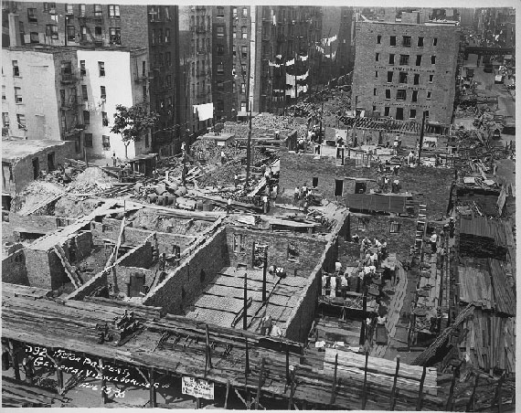
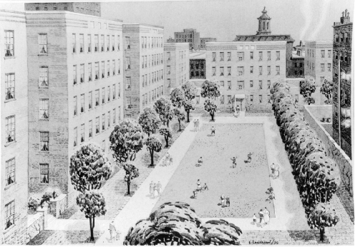
RAD 101: What is RAD and Why is it Happening?
ORIGINS OF PUBLIC HOUSING
Notes:
Construction of the 1st houses in NYC
Several important federal policies serve as the foundation for how public housing took shape.

Slide 7
RAD 101: What is RAD and Why is it Happening?
ORIGINS OF PUBLIC HOUSING
U.S. Housing Acts (in 1934, 1937 and 1947) sought to:
Revive the housing industry following the Great Depression;
Set national goals for housing quality; and
Establish subsidies for local public housing authorities
Notes:
Construction of the 1st houses in NYC
A series of U.S. Housing Acts (in 1934, 1937 and 1947) sought to revive the housing industry following the Great Depression, set new national goals for housing quality, and established subsidies for local public housing authorities.
These acts secured the money and political will needed to create public housing, but cities still needed to find the space to build them.

Slide 8
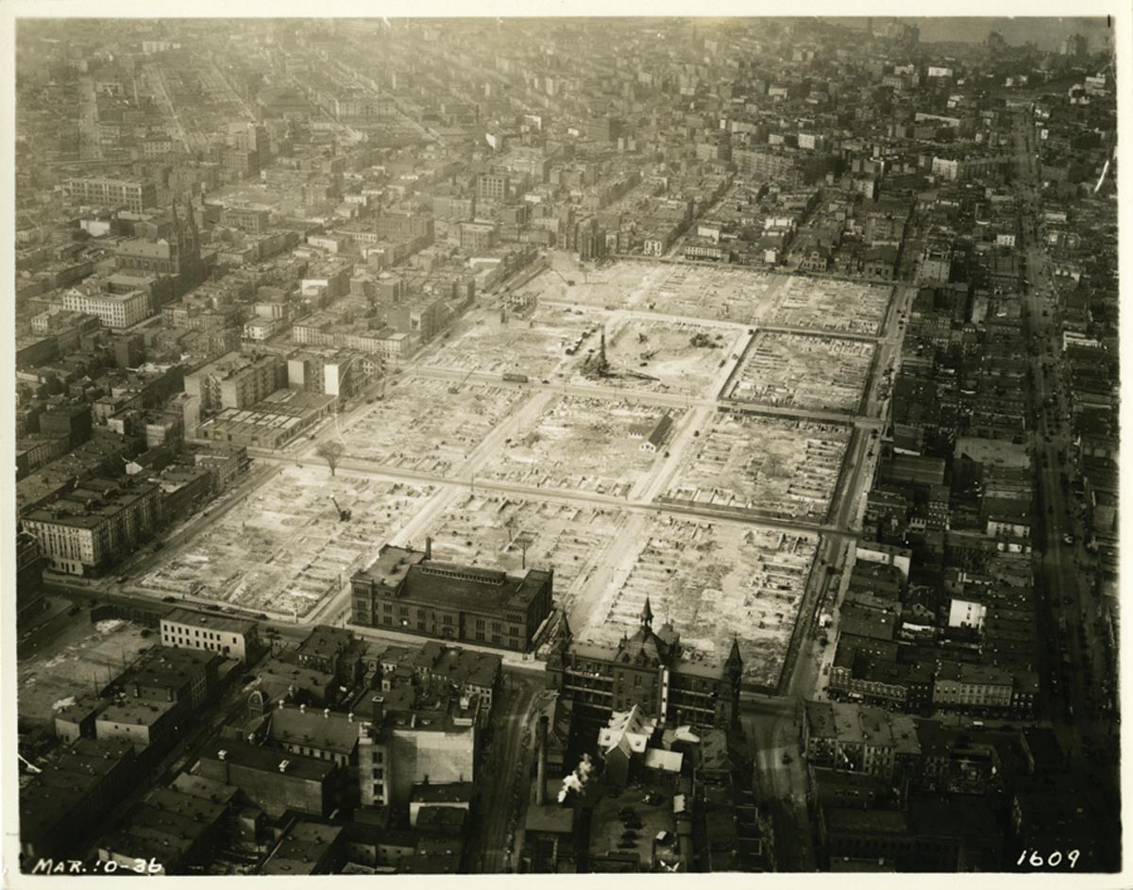
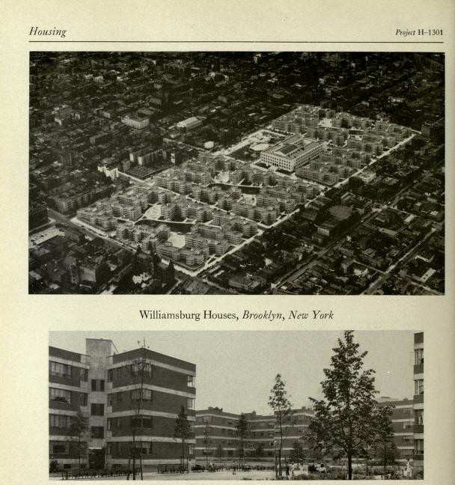
RAD 101: What is RAD and Why is it Happening?
ORIGINS OF PUBLIC HOUSING
Notes:
“Slum clearance” in Williamsburg to make way for the Williamsburg houses
Large urban renewal projects that contributed to the destruction of existing neighborhoods (called “slum clearance”) were used to make way for public housing developments and other infrastructure projects.

Slide 9
RAD 101: What is RAD and Why is it Happening?
ORIGINS OF PUBLIC HOUSING
Large urban renewal projects that contributed to the destruction of existing neighborhoods (called “slum clearance”) were used to make way for public housing developments and other infrastructure projects.
Notes:
“Slum clearance” in Williamsburg to make way for the Williamsburg houses
Large urban renewal projects that contributed to the destruction of existing neighborhoods (called “slum clearance”) were used to make way for public housing developments and other infrastructure projects.

Slide 10
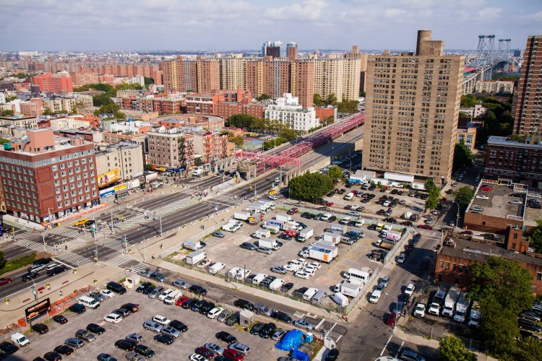
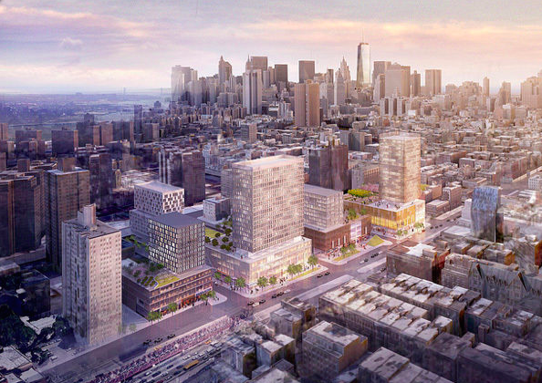
RAD 101: What is RAD and Why is it Happening?
ORIGINS OF PUBLIC HOUSING
Notes:
Seward Park Urban Renewal Area (SPURA) in 2012, and plans for Essex Crossing development. Thousands of people were forced to move away when this area was “cleared” in the 1960s, however plans for developing the site were stalled until 2013.
Unfortunately, this actually ended up decreasing the number of total housing units because demolished units were not replaced on a 1:1 basis.

Slide 11
RAD 101: What is RAD and Why is it Happening?
ORIGINS OF PUBLIC HOUSING
This ended up decreasing the number of total housing units since demolished units were not always replaced.
Notes:
Seward Park Urban Renewal Area (SPURA) in 2012, and plans for Essex Crossing development. Thousands of people were forced to move away when this area was “cleared” in the 1960s, however plans for developing the site were stalled until 2013.
Unfortunately, this actually ended up decreasing the number of total housing units because demolished units were not replaced on a 1:1 basis.

Slide 12
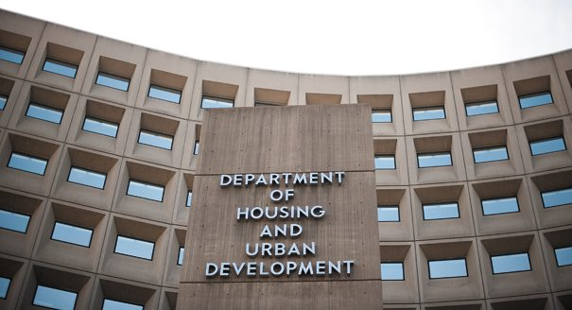
RAD 101: What is RAD and Why is it Happening?
ORIGINS OF PUBLIC HOUSING
Notes:
HUD was created in 1965 to address housing challenges throughout the country, and address city-related problems.

Slide 13
RAD 101: What is RAD and Why is it Happening?
ORIGINS OF PUBLIC HOUSING
HUD was created in 1965 to address housing challenges throughout the country, and address city-related problems.
Notes:
HUD was created in 1965 to address housing challenges throughout the country, and address city-related problems.

Slide 14
RAD 101: What is RAD and Why is it Happening?
ORIGINS OF PUBLIC HOUSING
Insert photo of development
NAME OF DEVELOPMENT
Built in 19XX
Home to roughly XXX residents
Notes:
FACILITATOR OPTION: Add in a slide showing when your development or the development you work with was built.

Slide 15
RAD 101: What is RAD and Why is it Happening?
ORIGINS OF PUBLIC HOUSING
Notes:
Many public housing developments were initially built along cities’ racial dividing lines. In the 60s and 70s, HUD started requiring that requiring that racial de-concentration become a priority in siting public housing.
This had an unintended consequences because communities began refusing federal funding to avoid the requirement and, as a result, caused a decline in the quantity of public housing units.

Slide 16
RAD 101: What is RAD and Why is it Happening?
ORIGINS OF PUBLIC HOUSING
In the 60s and 70s, HUD started requiring that racial de-concentration become a priority in siting public housing.
Communities began refusing federal funding to avoid the requirement and, as a result, caused a decline in the quantity of public housing units.
Notes:
Many public housing developments were initially built along cities’ racial dividing lines. In the 60s and 70s, HUD started requiring that requiring that racial de-concentration become a priority in siting public housing.
This had an unintended consequences because communities began refusing federal funding to avoid the requirement and, as a result, caused a decline in the quantity of public housing units.

Slide 17
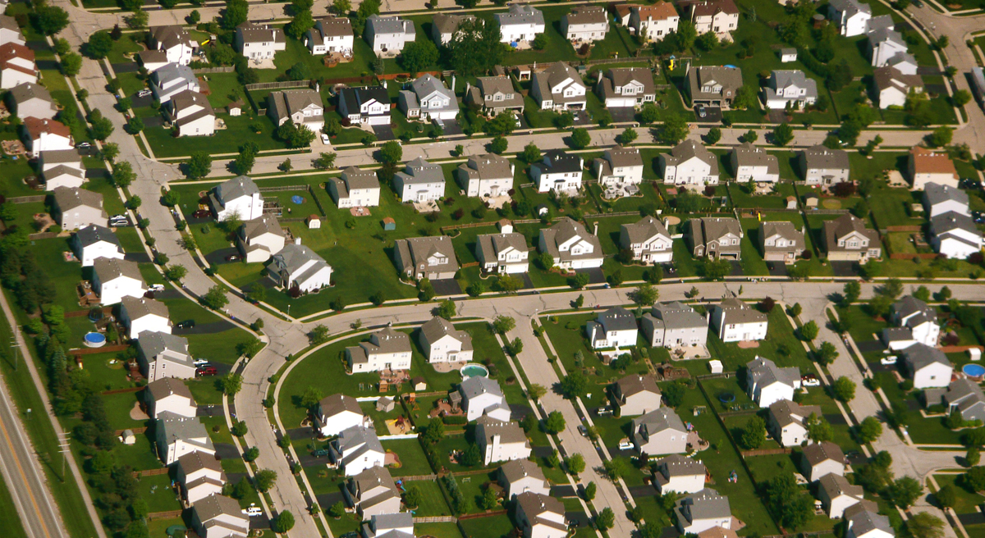
RAD 101: What is RAD and Why is it Happening?
ORIGINS OF PUBLIC HOUSING
Notes:
In parallel to these public housing policy shifts, incentives for home and car ownership supported white flight from cities to the suburbs, and contributed in part to the concentration of poverty within the public housing communities.
Much has changed since the 1930s, and public housing residents in NYC now face rapidly gentrifying neighborhoods and escalating costs of living. However, the impact of the decisions that were made decades ago can still be seen today. They have contributed to:
the isolation of public housing sites;
reduced public support;
and a decline in funding from the federal government.

Slide 18
RAD 101: What is RAD and Why is it Happening?
ORIGINS OF PUBLIC HOUSING
Incentives for home and car ownership supported white flight from cities to the suburbs, and contributed to:
The isolation of public housing sites;
Reduced public support; and
A decline in funding from the federal government
Notes:
In parallel to these public housing policy shifts, incentives for home and car ownership supported white flight from cities to the suburbs, and contributed in part to the concentration of poverty within the public housing communities.
Much has changed since the 1930s, and public housing residents in NYC now face rapidly gentrifying neighborhoods and escalating costs of living. However, the impact of the decisions that were made decades ago can still be seen today. They have contributed to:
the isolation of public housing sites;
reduced public support;
and a decline in funding from the federal government.

Slide 19
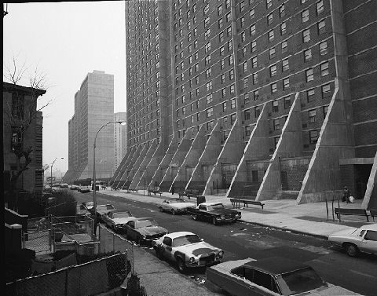
RAD 101: What is RAD and Why is it Happening?
ORIGINS OF PUBLIC HOUSING
Notes:
Initially it was assumed that rent could fund operating costs, but this was not adequate. PHAs were unable to keep up with the costs of service and maintenance and housing units began to fall into decline.
In an effort to close the gap between operating costs and PHA funding, the federal government raised tenant contribution from 25% of income to 30% in 1981.
Shortly after, many cities began to prioritize tenants with the lowest income. As public housing became housing for the neediest, many of those with the means to leave did so. Public housing in New York became an important stepping stone for many families to a better life during this period.

Slide 20
RAD 101: What is RAD and Why is it Happening?
ORIGINS OF PUBLIC HOUSING
To close the gap between operating costs and PHA funding, the federal government raised tenant contribution from 25% of household income to 30% in 1981.
Notes:
Initially it was assumed that rent could fund operating costs, but this was not adequate. PHAs were unable to keep up with the costs of service and maintenance and housing units began to fall into decline.
In an effort to close the gap between operating costs and PHA funding, the federal government raised tenant contribution from 25% of income to 30% in 1981.
Shortly after, many cities began to prioritize tenants with the lowest income. As public housing became housing for the neediest, many of those with the means to leave did so. Public housing in New York became an important stepping stone for many families to a better life during this period.

Slide 21
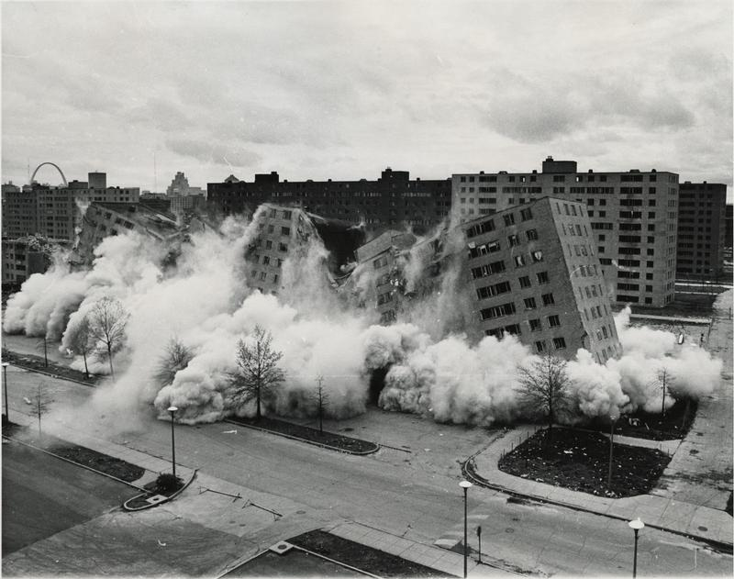
RAD 101: What is RAD and Why is it Happening?
ORIGINS OF PUBLIC HOUSING
Notes:
Pruitt-Igoe apartments in St. Louis, demolished in 1970’s because buildings had fallen into such bad disrepair
Unfortunately, the public and political support for subsidized housing was diminished in the 80s, and many units were lost because of:
housing maintenance costs that were higher than the subsidy and rents received
Mismanagement in some PHAs
Corruption amongst some private developers using public financing to create affordable housing
Demolishing developments that were severely distressed

Slide 22
RAD 101: What is RAD and Why is it Happening?
ORIGINS OF PUBLIC HOUSING
Public and political support for subsidized housing declined in the 80s, and many units were lost
Notes:
Pruitt-Igoe apartments in St. Louis, demolished in 1970’s because buildings had fallen into such bad disrepair
Unfortunately, the public and political support for subsidized housing was diminished in the 80s, and many units were lost because of:
housing maintenance costs that were higher than the subsidy and rents received
Mismanagement in some PHAs
Corruption amongst some private developers using public financing to create affordable housing
Demolishing developments that were severely distressed

Slide 23
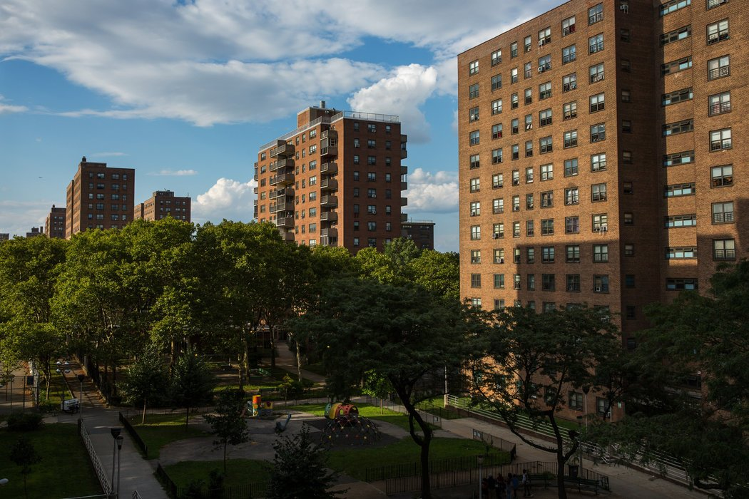
RAD 101: What is RAD and Why is it Happening?
ORIGINS OF PUBLIC HOUSING
Notes:
Public housing falls under Section 9 regulations, and cannot access any private funding.
There are currently only three revenue sources for PHAs to use under Section 9 regulations:
Rent
federal operating subsidy
federal capital funds.
HUD contracts were designed to cover the difference between rents received and operating costs. However, that is not the case today. NYCHA has been unable to keep up with the necessary maintenance.

Slide 24
RAD 101: What is RAD and Why is it Happening?
ORIGINS OF PUBLIC HOUSING
Public housing falls under Section 9 regulations, and cannot access any private funding.
HUD contracts are unable to cover the difference between rents received and operating costs and NYCHA has been unable to keep up with the necessary maintenance.
Notes:
Public housing falls under Section 9 regulations, and cannot access any private funding.
There are currently only three revenue sources for PHAs to use under Section 9 regulations:
Rent
federal operating subsidy
federal capital funds.
HUD contracts were designed to cover the difference between rents received and operating costs. However, that is not the case today. NYCHA has been unable to keep up with the necessary maintenance.

Slide 25
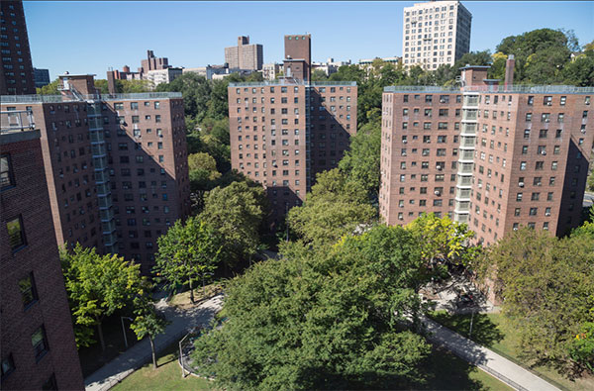
RAD 101: What is RAD and Why is it Happening?
ORIGINS OF PUBLIC HOUSING
Notes:
Today, NYCHA is a vital source of affordable housing in New York City, home to a population that is larger than the city of Atlanta.
Federal underfunding has left NYCHA with an unmet capital need of $17 billion. At the same time, federal underfunding has meant that NYCHA lost over $1 billion in operating funding since 2001.
NYCHA receives a total of $440 million:
$300M from the federal government
$40M from the State
$100M from the City
At this amount, it would take NYCHA almost 40 years to complete their current backlog of repairs.

Slide 26
RAD 101: What is RAD and Why is it Happening?
ORIGINS OF PUBLIC HOUSING
In 2017, NYCHA received a total of $440 million:
$300M from the federal government
$40M from the State
$100M from the City
At this amount, it would take NYCHA almost 40 years to complete their current backlog of repairs.
Notes:
Today, NYCHA is a vital source of affordable housing in New York City, home to a population that is larger than the city of Atlanta.
Federal underfunding has left NYCHA with an unmet capital need of $17 billion. At the same time, federal underfunding has meant that NYCHA lost over $1 billion in operating funding since 2001.
NYCHA receives a total of $440 million:
$300M from the federal government
$40M from the State
$100M from the City
At this amount, it would take NYCHA almost 40 years to complete their current backlog of repairs.

Slide 27
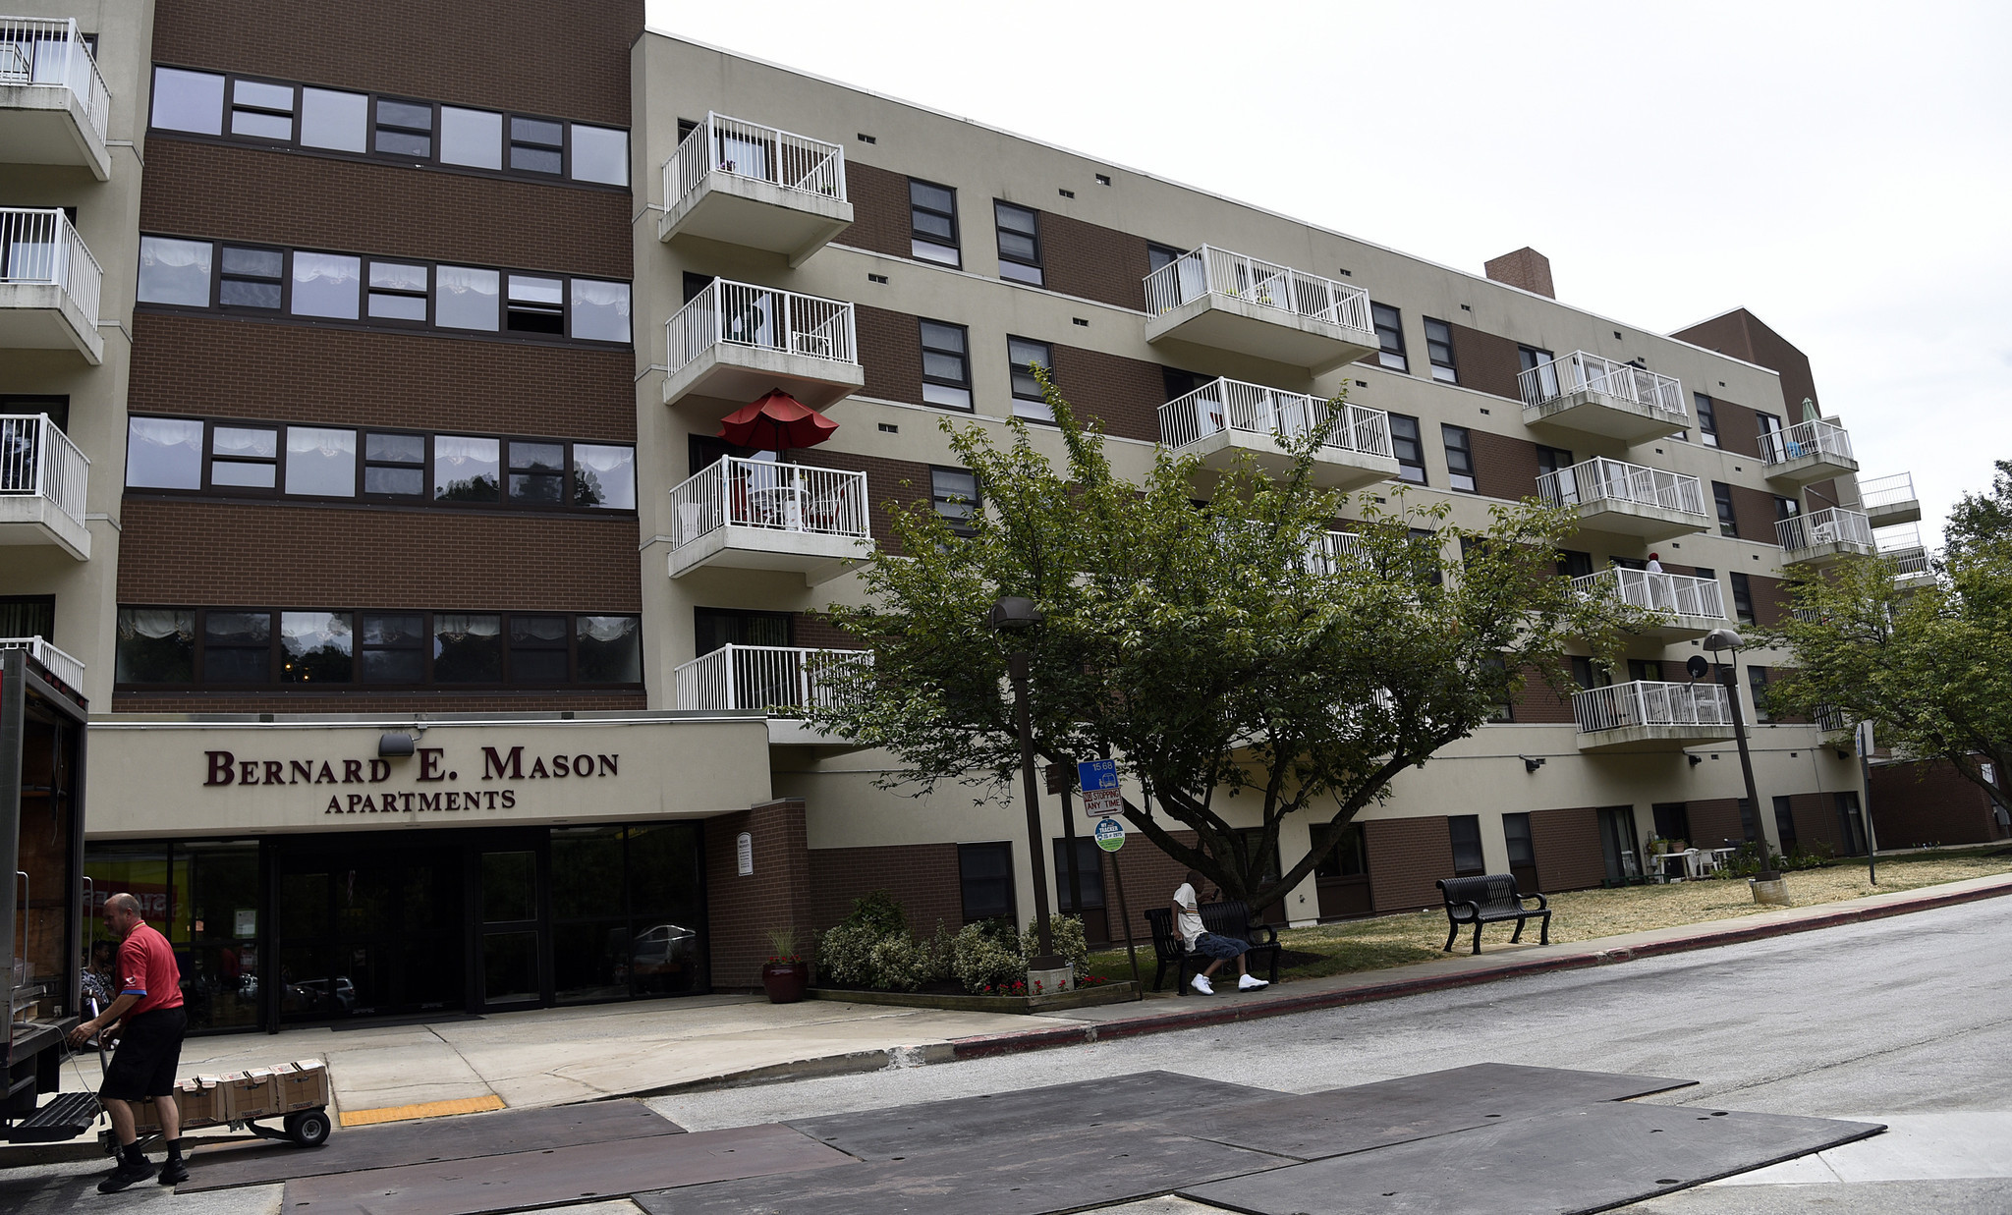
RAD 101: What is RAD and Why is it Happening?
ORIGINS OF PUBLIC HOUSING
Notes:
Pilot RAD site in Baltimore
The financial strain and persistent underfunding from the federal government is forcing NYCHA to find additional funding strategies to plug the gap. RAD was created as a pilot program to test out whether a conversion from public housing to Section 8 could help PHAs repair, renovate, and return needed services to residents where they otherwise couldn’t.

Slide 28
RAD 101: What is RAD and Why is it Happening?
ORIGINS OF PUBLIC HOUSING
RAD was created as a pilot program to test out whether a conversion from public housing to Section 8 could help PHAs repair, renovate, and return needed services to residents where they otherwise couldn’t.
Notes:
Pilot RAD site in Baltimore
The financial strain and persistent underfunding from the federal government is forcing NYCHA to find additional funding strategies to plug the gap. RAD was created as a pilot program to test out whether a conversion from public housing to Section 8 could help PHAs repair, renovate, and return needed services to residents where they otherwise couldn’t.

Slide 29
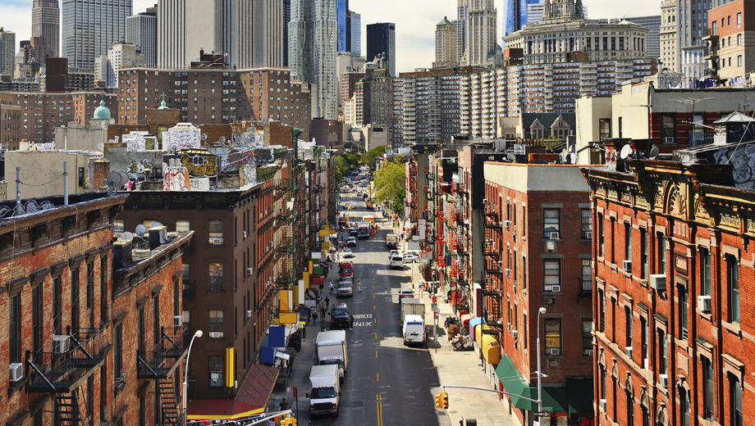
RAD 101: What is RAD and Why is it Happening?
ORIGINS OF PUBLIC HOUSING
Notes:
Section 8 was established in 1974, and allows private housing managers/owners to access federal funding to subsidize rent for low-income tenants.
Section 8 therefore uses a combination of private and federal funding and has historically been a more stable source of funding.

Slide 30
RAD 101: What is RAD and Why is it Happening?
ORIGINS OF PUBLIC HOUSING
The Section 8 program uses a combination of private and federal funding that has historically been a more stable.
Notes:
Section 8 was established in 1974, and allows private housing managers/owners to access federal funding to subsidize rent for low-income tenants.
Section 8 therefore uses a combination of private and federal funding and has historically been a more stable source of funding.

Slide 31
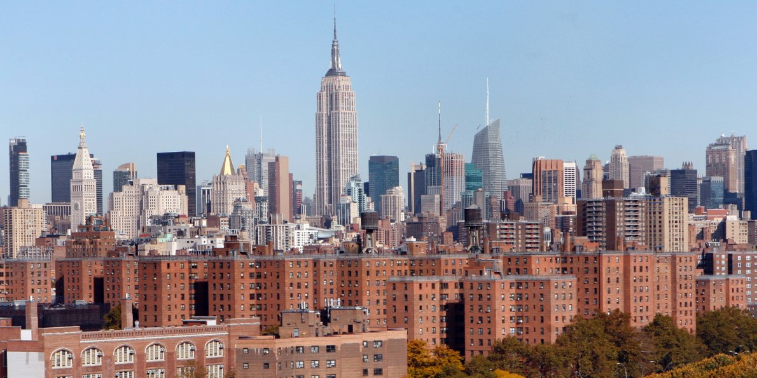
RAD 101: What is RAD and Why is it Happening?
ORIGINS OF PUBLIC HOUSING
Notes:
With market-rate rents and home sales prices continuing to rise, Public Housing plays a crucial role in maintaining affordable housing.
The need to preserve existing units is a big part of why the Rental Assistance Demonstration (RAD) program was created in 2011.

Slide 32
RAD 101: What is RAD and Why is it Happening?
ORIGINS OF PUBLIC HOUSING
With market-rate rents and home sales prices continuing to rise, Public Housing plays a crucial role in maintaining affordable housing.
The need to preserve existing units is a big part of why the Rental Assistance Demonstration (RAD) program was created in 2011.
Notes:
With market-rate rents and home sales prices continuing to rise, Public Housing plays a crucial role in maintaining affordable housing.
The need to preserve existing units is a big part of why the Rental Assistance Demonstration (RAD) program was created in 2011.

Slide 33
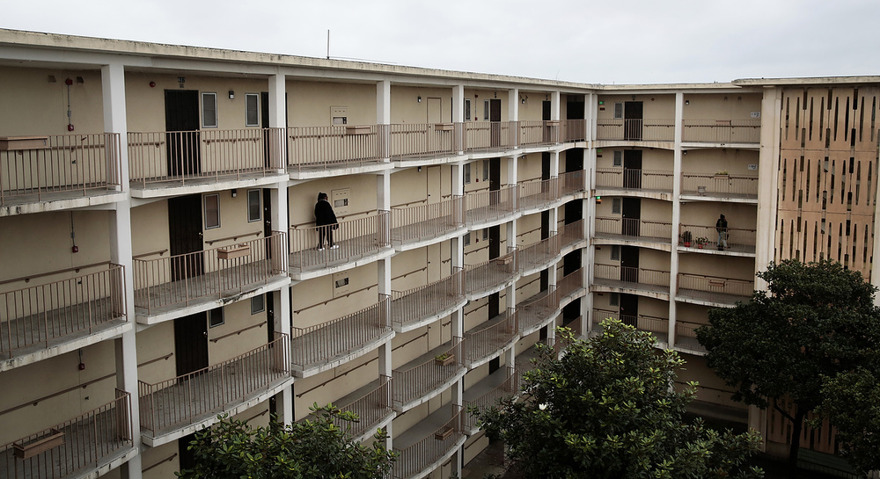
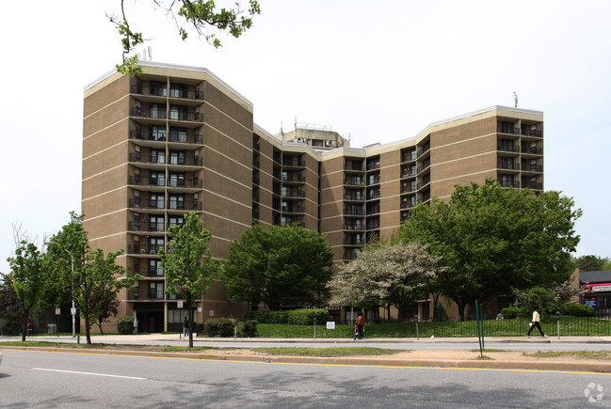
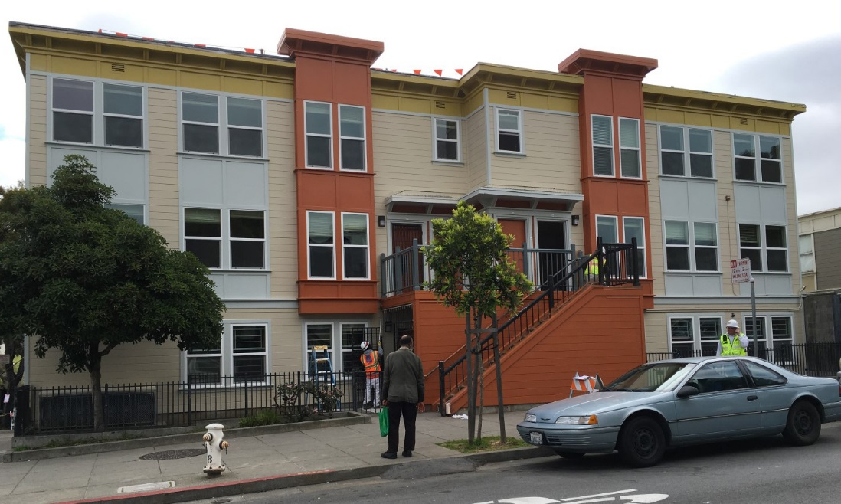
RAD 101: What is RAD and Why is it Happening?
ORIGINS OF PUBLIC HOUSING
Notes:
RAD sites in Richmond CA, San Francisco and Baltimore
RAD transitions public housing properties regulated by Section 9 to the Section 8 program. This shift, or “conversion” allows the additional sources of private funding to fund repairs and preserve public housing.

Slide 34
RAD 101: What is RAD and Why is it Happening?
ORIGINS OF PUBLIC HOUSING
RAD transitions public housing properties regulated by Section 9 to the Section 8 program.
Notes:
RAD sites in Richmond CA, San Francisco and Baltimore
RAD transitions public housing properties regulated by Section 9 to the Section 8 program. This shift, or “conversion” allows the additional sources of private funding to fund repairs and preserve public housing.

Slide 35
RAD Curriculum Guide: Your roadmap for understanding RAD: Rental Assistance Demonstration
RAD AT A GLANCE

Slide 36
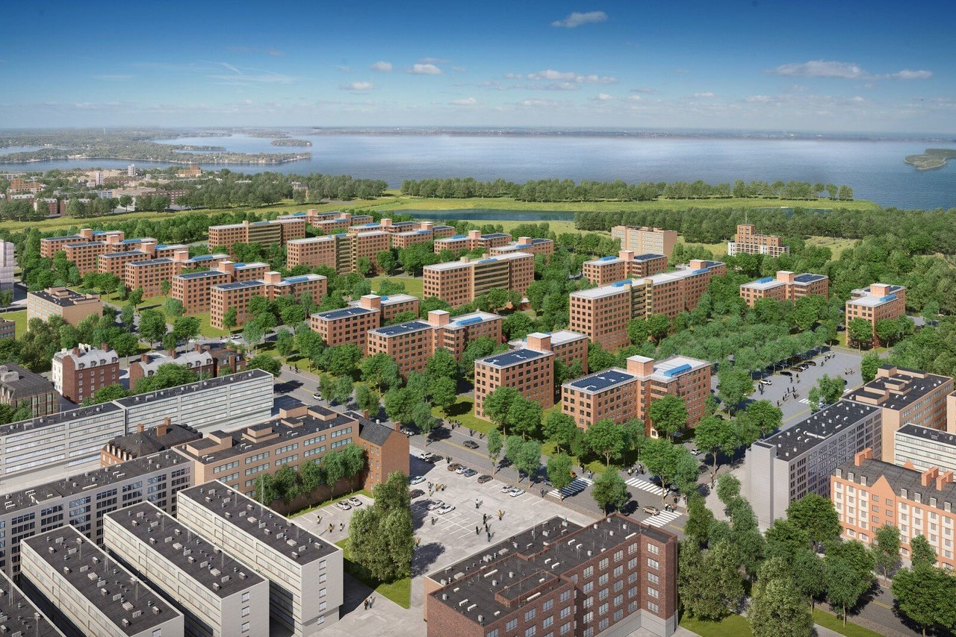
RAD 101: What is RAD and Why is it Happening?
RAD AT A GLANCE
Notes:
Ocean Bay apartments in the Rockaways
Goals of RAD:
Help PHAs become more financially stable through private market financing.
Guarantee long-term affordability and stability for existing public housing residents.
Address capital needs AND anticipated maintenance and repairs for a selected property over a 20-year period.

Slide 37
RAD 101: What is RAD and Why is it Happening?
RAD AT A GLANCE
Goals of the RAD Program:
Help PHAs become more financially stable through private market financing.
Guarantee long-term affordability and stability for existing public housing residents
Address capital needs AND anticipated maintenance and repairs for a selected property over a 20-year period.
Notes:
Ocean Bay apartments in the Rockaways
Goals of RAD:
Help PHAs become more financially stable through private market financing.
Guarantee long-term affordability and stability for existing public housing residents.
Address capital needs AND anticipated maintenance and repairs for a selected property over a 20-year period.

Slide 38
RAD 101: What is RAD and Why is it Happening?
RAD AT A GLANCE
Notes:
Funding for public housing requires support and approval from Congress. Historically, this funding has not been predictable and has not been enough. RAD was created as a tool to allow Public Housing Authorities (PHAs) to access other forms of financing to complete needed building improvements.

Slide 39
RAD 101: What is RAD and Why is it Happening?
RAD AT A GLANCE
Notes:
RAD is a preservation strategy: by changing the financing structure, developments can access additional funding streams to make repairs and preserve affordability.
A small percentage of households may have a rent increase that will be phased in over 5 years. NYCHA will eventually be raising rents to be set at 30% of income as well.

Slide 40
RAD 101: What is RAD and Why is it Happening?
RAD AT A GLANCE
KEY FEATURES
Transfer from the HUD public housing program to the Section 8 program

Slide 41
RAD 101: What is RAD and Why is it Happening?
RAD AT A GLANCE
KEY FEATURES
Transfer from the HUD public housing program to the Section 8 program
Transfer to alternative ownership and management

Slide 42
RAD 101: What is RAD and Why is it Happening?
RAD AT A GLANCE
KEY FEATURES
Transfer from the HUD public housing program to the Section 8 program
Transfer to alternative ownership and management
Funding for major capital improvements needed over the next 20 years

Slide 43
RAD 101: What is RAD and Why is it Happening?
RAD AT A GLANCE
KEY FEATURES
Transfer from the HUD public housing program to the Section 8 program
Transfer to alternative ownership and management
Funding for major capital improvements needed over the next 20 years
Ongoing affordability - rents set at 30% of household income

Slide 44
RAD 101: What is RAD and Why is it Happening?
RAD AT A GLANCE
WHO IS THE DEVELOPMENT TEAM?
Developer: responsible for carrying out renovations
Property Manager: responsible for day-to-day management
Service Provider: responsible for on site service programs

Slide 45
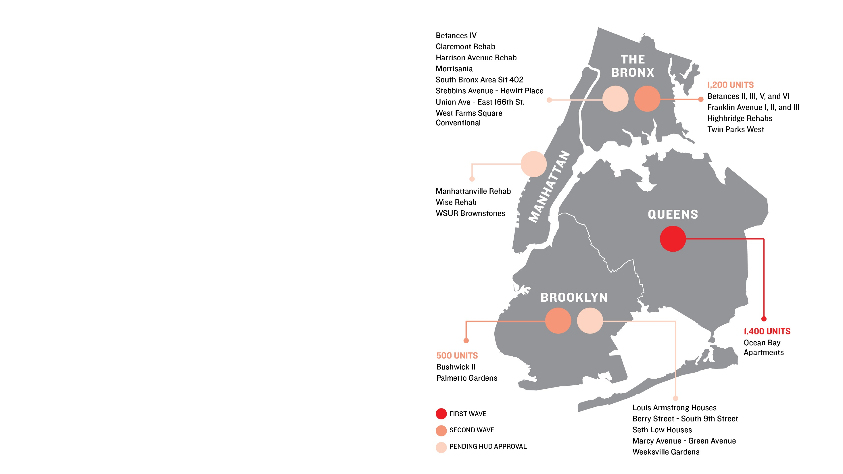
RAD 101: What is RAD and Why is it Happening?
RAD AT A GLANCE
NYCHA’S PLAN
Applied for 5,200 units as of June 2016
1,400 converted in Ocean Bay, Queens
1,700 approved in January 2017 split between Brooklyn and the Bronx
Goal is to convert 15,000 units – which represent 8% of portfolio and 18% of capital needs

Slide 46
RAD 101: What is RAD and Why is it Happening?
CONVERSION BASICS
CONVERSION TIMELINE

Slide 47
RAD Curriculum Guide: Your roadmap for understanding RAD: Rental Assistance Demonstration
RAD 101: What Can You Expect?
Benefits and Risks for Residents

Slide 48
RAD 101: What Can You Expect?
BENEFITS AND RISKS FOR RESIDENTS
BENEFITS AND RISKS FOR RESIDENTS
Notes:
Refer to Risks and Benefits section of RAD handbook

Slide 49
RAD 101: What Can You Expect?
BENEFITS AND RISKS FOR RESIDENTS
LIVING CONDITIONS
BENEFITS:
The renovation will cover major capital improvements projected over the next 20 years at your development.
RISKS/UNCERTAINTIES:
The risk that the developer may not complete renovations to quality standards may be minimized by the investors’ incentive to protect their investment.

Slide 50
RAD 101: What Can You Expect?
BENEFITS AND RISKS FOR RESIDENTS
LIVING CONDITIONS
BENEFITS:
NYCHA must inspect your apartment every two years to make sure it continues to meet federal housing quality standards. The owner will be required to address any deficiencies promptly to maintain Section 8 funding.
RISKS/UNCERTAINTIES:
You will have to provide access to your apartment for the inspector and for any needed renovations.

Slide 51
RAD 101: What Can You Expect?
BENEFITS AND RISKS FOR RESIDENTS
RENTS AND LEASES
BENEFITS:
Residents on the NYCHA lease at conversion will have the “right to stay” without rescreening. Those temporarily relocated during renovations will be guaranteed the “right to return” to their same development.
RISKS/UNCERTAINTIES:
After conversion, anyone living with you, who you have not added to the lease, may be required to leave.
If you are living in an under-occupied apartment, you may be moved to a different unit in the same development after renovation.

Slide 52
RAD 101: What Can You Expect?
BENEFITS AND RISKS FOR RESIDENTS
RENTS AND LEASES
BENEFITS:
Your rent will be affordable and set at 30 percent of household income.
RISKS/UNCERTAINTIES:
Households now paying less than 30 percent will experience a rent increase, to be phased in over a 5-year period.
Notes:
*In order to avoid any surprises or restrictions, you need to pay attention to the lease changes and documents you’ll have to sign. Residents must make sure all household members are on their existing lease to ensure their right to stay after conversion.
*Make sure you talk to your property manager about adding members to your lease and/or registering pets and appliances and look out for opportunities to make these additions. We will discuss this further in Section 2.

Slide 53
RAD 101: What Can You Expect?
BENEFITS AND RISKS FOR RESIDENTS
RENTS AND LEASES
BENEFITS:
Your development will remain affordable low-income housing. Every 20 years HUD and the owner are required to renew arrangements.
RISKS/UNCERTAINTIES:
RAD and the public housing program—like any other federal program—are subject to legislative and funding changes in Washington.

Slide 54
RAD 101: What Can You Expect?
BENEFITS AND RISKS FOR RESIDENTS
PROGRAM ARRANGEMENTS
BENEFITS:
Your resident organization will continue to be funded each year at up to $25 per occupied unit.
RISKS/UNCERTAINTIES:
Arrangements will have to be worked out with the new manager for receiving and using the funds.

Slide 55
RAD 101: What Can You Expect?
BENEFITS AND RISKS FOR RESIDENTS
PROGRAM ARRANGEMENTS
BENEFITS:
As a result of this work, resident training and job opportunities will open up in construction and in permanent management.
RISKS/UNCERTAINTIES:
Residents may lose access to NYCHA-run job training programs
If existing NYCHA employees are not hired by the new property manager they will be relocated to other sites
Notes:
In addition to job opportunities, the new property manager is required to develop a plan for resident services and programs. There will be opportunities for tenants to advocate for specific services or provide input on their service needs and priorities. You’ll want to take advantage of opportunities to weigh in on these plans, so be sure to pay attention to the timeline, and meeting notices that you should receive.

Slide 56
RAD 101: What Can You Expect?
BENEFITS AND RISKS FOR RESIDENTS
CHANGE IN FINANCING AND OWNERSHIP
BENEFITS:
The private financing that RAD unlocks will allow for quick repairs and renovation, and work should be completed with 2 years. With private ownership, the new property management may be better quality.
RISKS/UNCERTAINTIES:
Because each development will have a different new property manager, the quality of new management is unknown.

Slide 57
To maximize the benefits of RAD conversion and minimize the risks, residents need to help keep each other informed throughout the conversion process.
NEXT UP: PREPARE FOR RAD

